Slide 1
HOTEL RESERVATION ANALYSIS
PROJECT 1
SQL
By Sakthivel Rajan

Slide 2
OVERVIEW
The hotel industry relies on data to make informed decisions and provide a better guest experience.
I worked with a hotel reservation dataset to gain insights into guest preferences, booking trends and other key factors that impact the hotel’s operations.
I used SQL Server to query and analyse the data, as well as answer specific questions about the dataset.

Slide 3
Data Description
The data set is in a Excel format. The data set contains 700 rows and has 12 columns. It is a data set collected for the years 2017 and 2018. The data set contains the following:
Booking ID: A unique identifier for each hotel reservation.
No of adults: The number of adults in the reservation.
No of children: The number of children in the reservation.
No of weekend nights: The number of nights in the reservation that fall on weekends.
No of week nights: The number of nights in the reservation that fall on weekdays.

Slide 4
Type of meal plan: The meal plan chosen by the guests.
Room type reserved: The type of room reserved by the guests.
Lead time: The number of days between booking and arrival.
Arrival date: The date of arrival.
Market segment type: The market segment to which the reservation belongs.
Average price per room: The average price per room in the reservation.
Booking status: The status of the booking.

Slide 5

What is the total number of reservation in the dataset?
QUERY 1
SELECT COUNT(*) AS Total_Count
FROM [Hotel Reservation];
Result
Insights: Understanding the total number of reservations provides an overview of the dataset’s size and the hotel’s overall booking volume.

Slide 6
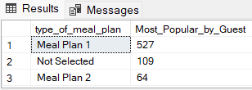
Which meal plan is the most popular among guests?
QUERY 2
SELECT type_of_meal_plan, COUNT(*) AS Most_Popular_by_Guest FROM [Hotel Reservation]
GROUP BY type_of_meal_plan
ORDER BY Most_Popular_by_Guest DESC;
Result
Insights: Identifying the most popular meal plan among guests helps the hotel understand guest preferences and tailor their offerings accordingly.

Slide 7
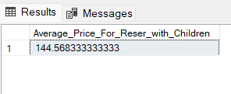
What is the average price per room for reservations involving children?
QUERY 3
SELECT AVG(avg_price_per_room) AS Average_Price_For_Reser_with_Children
FROM [Hotel Reservation]
WHERE no_of_children>0;
Result
Insights: Calculating the average price per room for reservations involving children can help the hotel set pricing strategies and package deals for families.

Slide 8

How many reservations were made for the year 20XX (replace XX with the desired year)?
QUERY 4
SELECT COUNT(Booking_ID) AS Total_reservation_2018
FROM [Hotel Reservation]
WHERE YEAR(arrival_date)='2018’;
Result
Insights: Analysing reservations made for a particular year helps in understanding booking trends over time and aids in forecasting future demand.

Slide 9
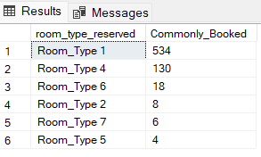
What is the most commonly booked room type?
QUERY 5
SELECT room_type_reserved, COUNT(*) AS Commonly_Booked
FROM [Hotel Reservation]
GROUP BY room_type_reserved
ORDER BY Commonly_Booked DESC;
Result
Insights: Knowing the most commonly booked room type allows the hotel to optimize room allocation and potentially adjust room rates based on demand.

Slide 10

How many reservations fall on a weekend (no_of_weekend_nights>0)?
QUERY 6
SELECT COUNT(Booking_ID) AS Weekend_Reservation
FROM [Hotel Reservation]
WHERE no_of_weekend_nights>0;
Result
Insights: Identifying the number of reservations that fall on weekends provides insights into peak booking periods, allowing the hotel to plan staffing and resources accordingly.

Slide 11

What is the highest and lowest lead time for reservations?
QUERY 7
SELECT MAX(lead_time) AS Highest_lead_time, MIN(lead_time) AS Lowest_lead_time
FROM [Hotel Reservation];
Result
Insights: Understanding the highest and lowest lead times for reservations helps the hotel manage inventory and optimize revenue management strategies.

Slide 12
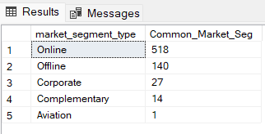
What is the most common market segment type for reservations?
QUERY 8
SELECT market_segment_type, COUNT(*) AS Common_Market_Seg
FROM [Hotel Reservation]
GROUP BY market_segment_type
ORDER BY Common_Market_Seg DESC;
Result
Insights: Knowing the most common market segment type for reservations enables the hotel to tailor marketing efforts and services to specific customer segments.

Slide 13

How many reservations have a booking status of “Confirmed”?
QUERY 9
SELECT COUNT(*) AS Booking_Confirmed
FROM [Hotel Reservation]
WHERE booking_status ='Not_Canceled';
Result
Insights: Tracking the number of confirmed reservations helps in assessing booking conversion rates and forecasting revenue more accurately.

Slide 14
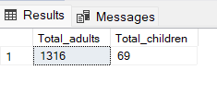
What is the total number of adults and children across all reservations?
QUERY 10
SELECT SUM(no_of_adults) AS Total_adults, SUM(no_of_children) AS Total_children
FROM [Hotel Reservation];
Result
Insights: Understanding the total number of adults and children across all reservations provides insights into the hotel’s guest demographics and helps in resource planning.

Slide 15

What is the average number of weekend nights for reservations involving children?
QUERY 11
SELECT AVG(no_of_weekend_nights) AS Average_Weekend_nights
FROM [Hotel Reservation]
WHERE no_of_children>0;
Result
Insights: Calculating the average number of weekend nights for reservations involving children helps the hotel understand family travel patterns and tailor offerings accordingly.

Slide 16
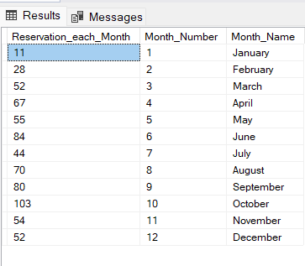
How many reservations were made in each month of the year?
QUERY 12
SELECT COUNT(Booking_ID) AS Reservation_each_Month, MONTH(arrival_date) AS Month_Number, DATENAME(MONTH,arrival_date) AS Month_Name
FROM [Hotel Reservation]
GROUP BY MONTH(arrival_date),
DATENAME(MONTH, arrival_date)
ORDER BY Month_Number;
Result
Insights: Analysing reservations made in each month of the year reveals seasonal booking patterns, which can inform pricing strategies and marketing campaigns.

Slide 17
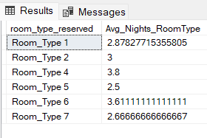
What is the average number of nights(both weekend and weekday) spent by guests for each room type?
QUERY 13
SELECT room_type_reserved, AVG(no_of_weekend_nights+no_of_week_nights) AS Avg_Nights_RoomType
FROM [Hotel Reservation]
GROUP BY room_type_reserved;
Result
Insights: Understanding the average number of nights spent by guests for each room type helps in optimizing room inventory and pricing strategies.

Slide 18
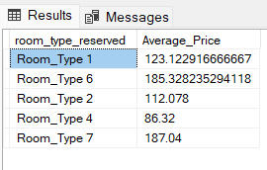
For reservations involving children, what is the most common room type, and what is the average price for that room type?
QUERY 14
SELECT room_type_reserved, AVG(avg_price_per_room) AS Average_Price FROM [Hotel Reservation]
WHERE no_of_children>0
GROUP BY room_type_reserved
ORDER BY COUNT(room_type_reserved) DESC;
Result
Insights: Identifying the most common room type for reservations involving children helps the hotel allocate rooms effectively and potentially adjust room rates for family-friendly accommodations.

Slide 19

Find the market segment type that generates the highest average price per room?
QUERY 15
SELECT TOP 1 market_segment_type, AVG(avg_price_per_room) AS Avg_Price_Room
FROM [Hotel Reservation]
GROUP BY market_segment_type
ORDER BY Avg_Price_Room DESC;
Result
Insights: Finding the market segment type that generates the highest average price per room allows the hotel to focus on high-value customer segments and tailor services to meet their needs.

Slide 20
THANK YOU

